Slide 1
P12 Hack-a-Shaq 6th Presentation
A113 – Mathematics

Slide 2
Assumptions
There are many possible complications in this analysis. Hence, we make certain assumptions in order to simplify our analysis. Some of the assumptions are:
No one from either team can score except for Shaq when Dallas Mavericks adopts the “Hack-a-Shaq” strategy.
4 fouls will be committed on Shaq in the remaining 2 minutes of play, resulting in Shaq being awarded 8 free throws.

Slide 3
Analysing the problem
We can view each of the 8 free throws as a “trial”.
i.e. The number of trials, n, is fixed at 8.
We assumed that the “success” or “failure” of each free throw is not related to the outcome of any of the previous free throws.
i.e. Each trial is independent.
Shaq either scores or misses a free throw.
i.e. Each trial has only two possible outcomes.
We assumed that the probability of Shaq scoring in each free throw remains the same.
i.e. p is assumed to be 0.528 for each of the 8 free throws.

Slide 4
Binomial distribution
A scenario that satisfies the following conditions is said to follow a binomial distribution:
The number of trials, n, is fixed.
Each trial is independent.
Each trial has only two possible outcomes ("success" or "failure").
The probability of "success", p, is the same for each trial.
Therefore, our scenario follows a binomial distribution.

Slide 5
Probability of k “successes”
out of n trials
Probability of getting k “successes” out of n trials =
Number of ways of getting k “successes”
Probability of getting k “successes” out of n trials for one particular scenario
For example, if k = 7 and n = 8, one particular scenario is the first trial being unsuccessful and the remaining trials being successful, i.e. FSSSSSSS.

Slide 6
Number of ways of getting k “successes”
There are a few methods to find out the number of ways of getting k “successes”.
Using tree diagrams
Listing out all possibilities
Drawing out Pascal’s triangle
However, these methods can be rather tedious especially when the number of trials is large.

Slide 7
Permutation or Combination
Recall the idea of Permutation and Combination from P10.
To find the number of ways of getting k “successes” out of n trials where the order is not important, we can make use of the idea of Combination.

Slide 8
Probability of 7 “successes” out of 8 trials
Probability of getting 1 successful free throw, P(S), is 0.528.
Probability of getting 7 successful free throws out of 8 throws = P(SSSSSSSF) + P(SSSSSSFS) + … + P(FSSSSSSS) = (No. of ways to get 7 “successes” out of 8 trials) P(SSSSSSSF) = ⁸C₇ (0.528)⁷ (1 - 0.528)¹
Note: P(SSSSSSSF) = P(SSSSSSFS) = P(SSSSSFSS) = P(SSSSFSSS) = P(SSSFSSSS) = P(SSFSSSSS) = P(SFSSSSSS) = P(FSSSSSSS) = (0.528)⁷ × (1 - 0.528)¹

Slide 9
Probability of k “successes”
out of n trials
Probability of getting k “successes” out of n trials = ^{n}C_{k} (p)^{k} (1 - p)^{n-k}
where p represents the probability of one “success”
Number of ways of getting k “successes” out of n trials
Probability of getting k “successes” out of n trials for 1 particular scenario

Slide 10
Chances of winning the game
Dallas Mavericks is leading Phoenix Suns 94-89 in the last 2 minutes. Dallas Mavericks will win if Shaq scores less than 5
out of the 8 free throws (i.e. 4 or less).
Let X denote the number of successful free throws.
P(X < 5) = P(X = 0) + P(X = 1) + P(X = 2) + P(X = 3) +P(X = 4)
= 0.00246 + 0.02205 + 0.08631 + 0.19311+0.27002
= 0.57395 ≈0.574
Therefore, the chance of Dallas Mavericks winning the game is 0.574.

Slide 11
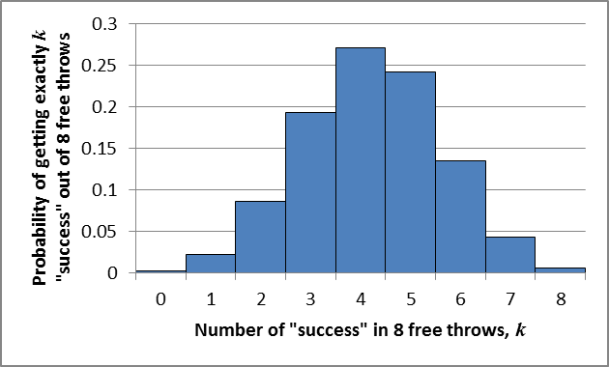
Binomial probability distribution
Probability of getting exactly k “successes” out of 8 free throws
(for probability of success = 0.528)
Probability of getting exactly k “successes” out of 8 free throws
Number of “successes” in 8 free throws, k

Slide 12
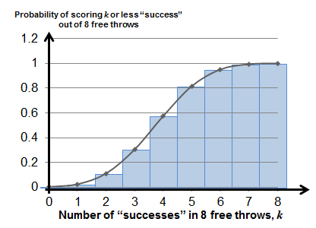
Binomial probability distribution
Probability of getting k or less “successes” out of 8 free throws
(for probability of success = 0.528)
P(X ≤ 8) = 1 since all possible scenarios are covered
Probability of scoring k or less “successes” out of 8 free throws
From this graph, it can be approximated that
P(X ≤ 4) ≈ 0.574

Slide 13
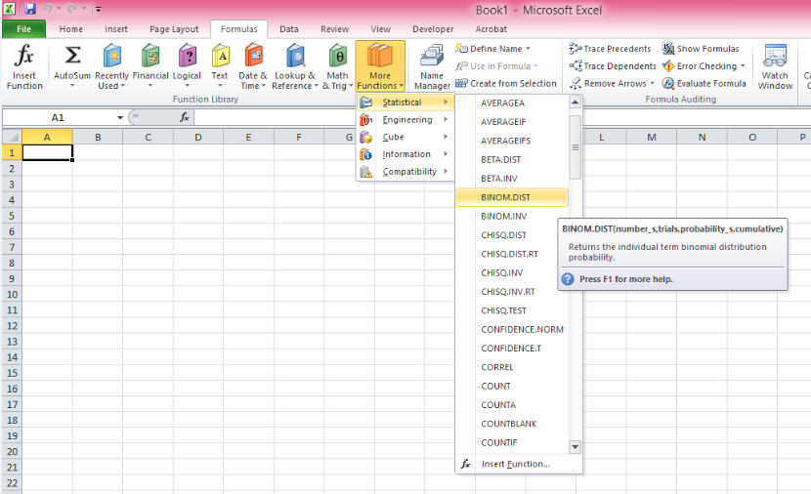
Use of MS Excel
Open the BINOMDIST tab

Slide 14
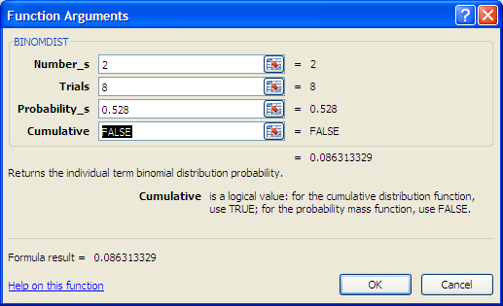
Use of MS Excel
We can now use the EXCEL function BINOMDIST to find the answer of P(X = 2).
Number_s: Refers to the number of successful free throws, k
Trials: Refers to the total number of trials, n
Probability_s: Refers to the probability of “success”, p
Cumulative: FALSE refers to exactly k “successes”

Slide 15
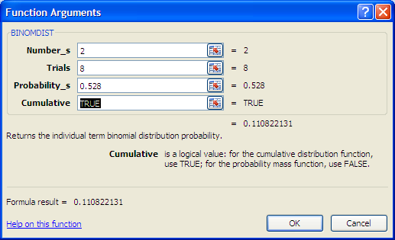
Use of MS Excel
We can now use the EXCEL function BINOMDIST to find the answer of P(X ≤ 2).
Number_s: Refers to the number of successful free throws, k
Trials: Refers to the total number of trials, n
Probability_s: Refers to the probability of “success”, p
Cumulative: TRUE refers to k or less “successes”

Slide 16
Worked Example (Practice Exercise Q4)
A biased coin is tossed 7 times.
The probability of obtaining a “Head” on any single toss is 0.4.
Calculate the probability of
a) Obtaining 2 “Heads”.
b) Obtaining less than 2 “Heads”.
c) Obtaining at most 2 “Heads”.
Let X denote the number of “Heads” in 7 tosses.
P (X = 2) = ⁷C₂×(0.4)²×(1 – 0.4)⁷⁻² = 0.261274 ≈ 0.261
P (X< 2) = P(X=0) + P(X=1)
= ⁷C₀×(0.4)⁰×(1 – 0.4)⁷⁻⁰ + ⁷C₁×(0.4)¹×(1 – 0.4)⁷⁻¹
= 0.15863 ≈ 0.159
P (X≤ 2) = P(X=0) + P(X=1) + P(X=2)
= ⁷C₀×(0.4)⁰×(1 – 0.4)⁷⁻⁰ + ⁷C₁×(0.4)¹×(1 – 0.4)⁷⁻¹ +⁷C₂×(0.4)²×(1 – 0.4)⁷⁻²
= 0.419904 ≈ 0.420

Slide 17
Worked Example (Practice Exercise Q4)
A biased coin is tossed 7 times.
The probability of obtaining a “Head” on any single toss is 0.4.
Calculate the probability of
d) Obtaining more than 2 “Heads”.
e) Obtaining at least 2 “Heads”.
Let X denote the number of “Heads” in 7 tosses.
P (X > 2) = 1 – P(X ≤ 2)
= 1 – 0.419904
= 0.580096 ≈ 0.580
P (X ≥ 2) = P(X=2)+P(X=3)+P(X=4)+P(X=5)+P(X=6)+P(X=7)
= 1 – P(X≤ 1)
= 1– 0.15863
= 0.84137 ≈ 0.841

Slide 18
Worked Example (Practice Exercise Q7)
At an electronics manufacturing firm, chips are packed in packets of 10 and sent for quality inspection. The probability of a manufactured chip being defective is 5%. Assume that chip defects are independent.
For a randomly selected packet,
a) determine the probability that it contains 2 defective chips.
b) determine the probability that it contains at most 2 defective chips.
c) What is the probability that it contains more than 1 defective chip?
Let X denote the number of defective chips in a packet.
P (X = 2) = ¹⁰C₂×(0.05)²×(1 – 0.05)¹⁰⁻² = 0.07463 ≈0.0746
P (X ≤ 2) = P (X = 0) + P (X = 1) + P (X = 2)
=¹⁰C₀×(0.05)⁰×(1–0.05)¹⁰⁻⁰ +¹⁰C₁×(0.05)¹×(1–0.05)¹⁰⁻¹ + ¹⁰C₂×(0.05)² ×(1–0.05)¹⁰⁻² = 0.988496 ≈0.988
P(X>1)=P(X=2)+P(X=3)+P(X=4)+P(X=5)+P(X=6)+P(X=7)+P(X=8)+P(X=9)+P(X=10)
= 1 – P(X≤1) = 1 – P(X=0) – P(X=1)
= 1 – ¹⁰C₀×(0.05)⁰×(1–0.05)¹⁰⁻⁰ – ¹⁰C₁×(0.05)¹×(1–0.05)¹⁰⁻¹
= 0.086138 ≈0.0861

Slide 19
Worked Example (Practice Exercise Q7)
For 2 randomly selected packets,
d) determine the probability that both packets each contain more than 1 defective chip.
For 5 randomly selected packets,
e) determine the probability that at least 3 packets each contain more than 1 defective chip.
From part (c),
probability that a packet contains more than 1 defective chip is 0.086138.
P(both contain more than 1 defective chip ) = (0.086138)² = 0.0074198 ≈ 0.00742
n = 5, p = 0.086138
Let Y denote the number of packets out of 5 which contains more than 1 defective chip.
P (Y ≥ 3) = P (Y = 3) + P (Y = 4) + P (Y = 5)
=⁵C₃×(0.086138)³×(1–0.086138)⁵⁻³+⁵C₄×(0.086138)⁴×
(1–0.086138)⁵⁻⁴+⁵C₅×(0.086138)⁵×(1 – 0.086138)⁵⁻⁵
= 0.005593956 ≈ 0.00559

Slide 20
Learning Objectives
State the conditions under which a binomial distribution can be used to calculate the probability of a real-life event
Calculate the number of ways to obtain k “successes” in n trials
Find the probability of k “successes” out of n trials
Find the probability of k “successes” out of n trials and the probability of k “successes” or less out of n trials from the graphs of a binomial distribution

Slide 21
Exploring Further
Instead of the given scenario in the problem statement, suppose the head coach of Dallas Mavericks had decided to adopt the Hack-a-Shaq strategy earlier on with 3 minutes remaining when the score was 95-89 with Phoenix Suns trailing by 6 points. This time round, Shaq is forced to take 12 free throws.
What is the chance of Dallas Mavericks winning the match this time? (You may assume that there are no field goal attempts by anyone else in this last 3 minutes.)
Let X denote the number of successful free throws out of 12 made by Shaq.
For Dallas Mavericks to win, Shaq must make less than 6 successful free throws.
Probability of Dallas Mavericks winning
= P (X < 6)
= P (X ≤ 5)
= BINOMDIST(5,12,0.528,TRUE)
≈ 0.314

Slide 22
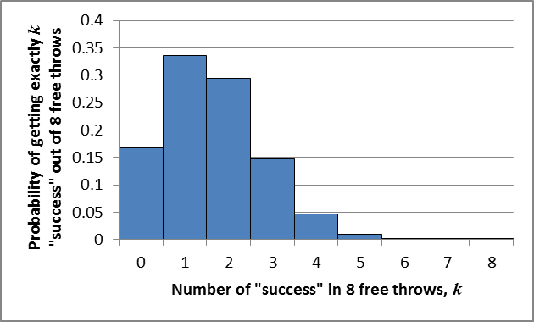
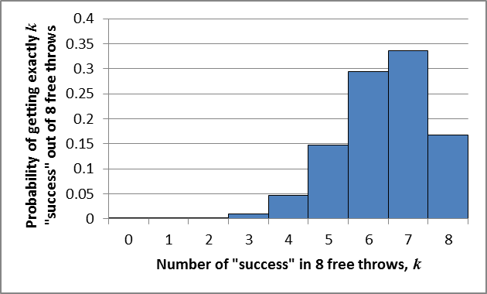
Exploring Further
For probability of success = 0.2,
the graph is skewed towards the right. Getting exactly 1 success has the highest probability.
Probability of getting exactly k “successes” out of 8 free throws
Number of “successes” in 8 free throws, k
For probability of success = 0.8,
the graph is skewed towards the left. Getting exactly 7 successes has the highest probability.
Probability of getting exactly k “successes” out of 8 free throws
Number of “successes” in 8 free throws, k

